Slide 1





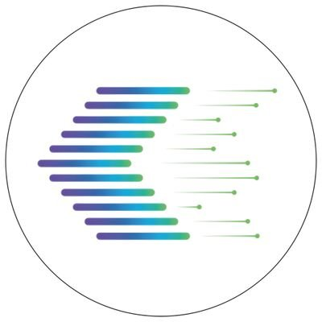

Data-Driven Medicine: Advancing Healthcare Using AI and Big Data
Fahad Almsned, M.D., Ph.D., M.A.S.
Director, Advanced Analytics and Predictive Modelling at Eastern Health Cluster (E1)
Associate Consultant of Bioinformatics at KFSH-D
Director, Research Operations at KFSH-D
Institutional Review Board (IRB) Chairperson at KFSH-D
Affiliated Graduate Faculty at George Mason University
R&D Consultant and Member of the Board of Advisors at GeneoClinic
Health Track Lead, Artificial Intelligence Governance Association

Slide 2
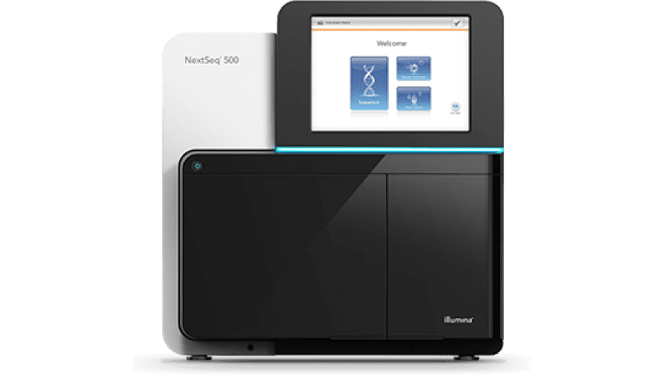
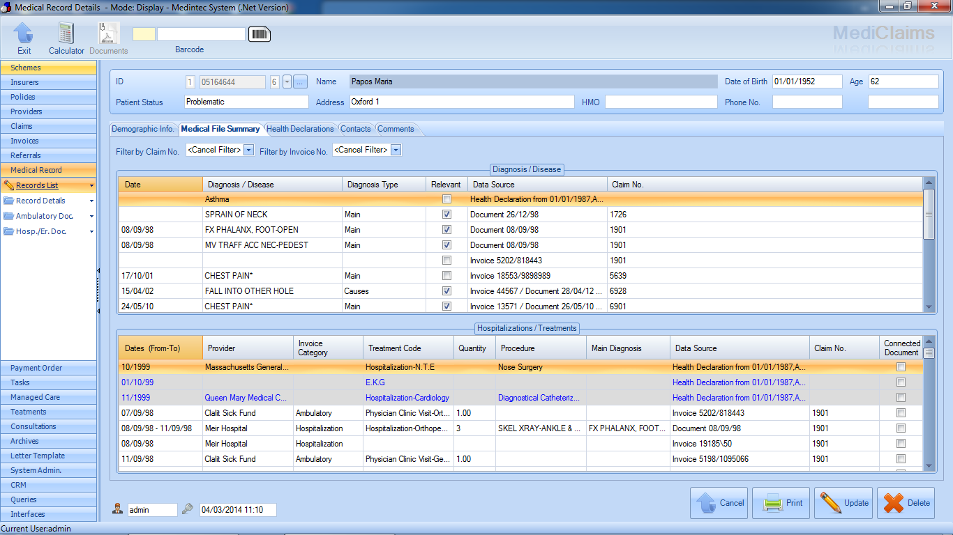
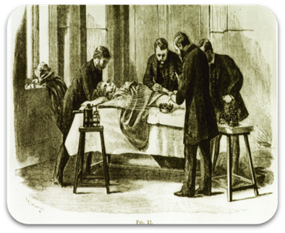

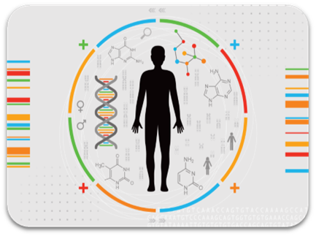
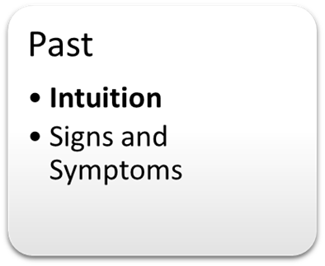
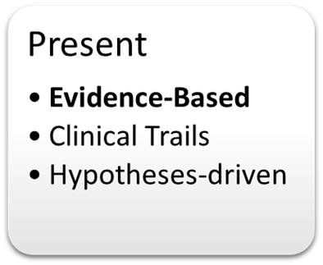
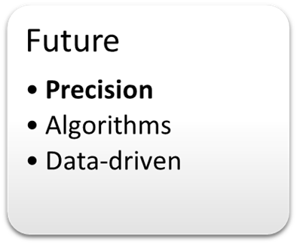
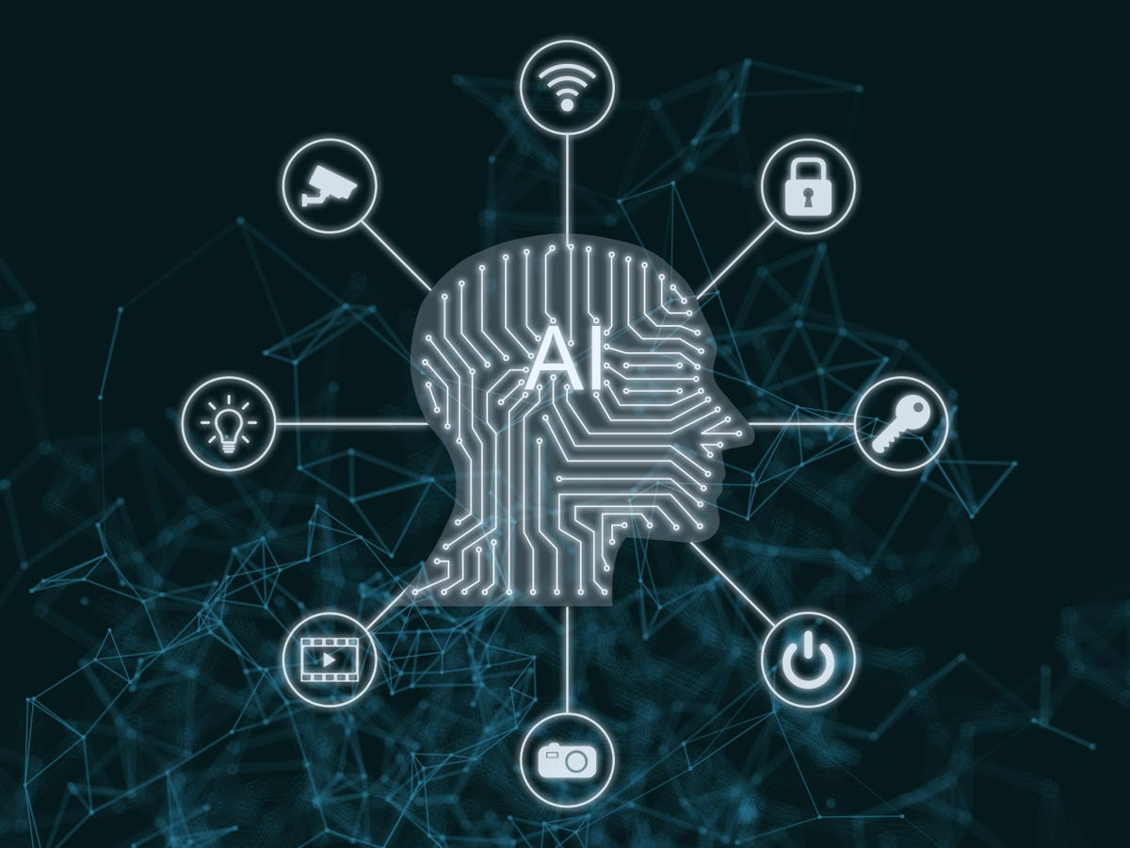
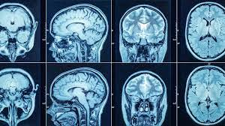
The Evolution Of Medicine
Transforming To Data-driven Medicine
Auler-Júnior et al., 2018

Slide 3
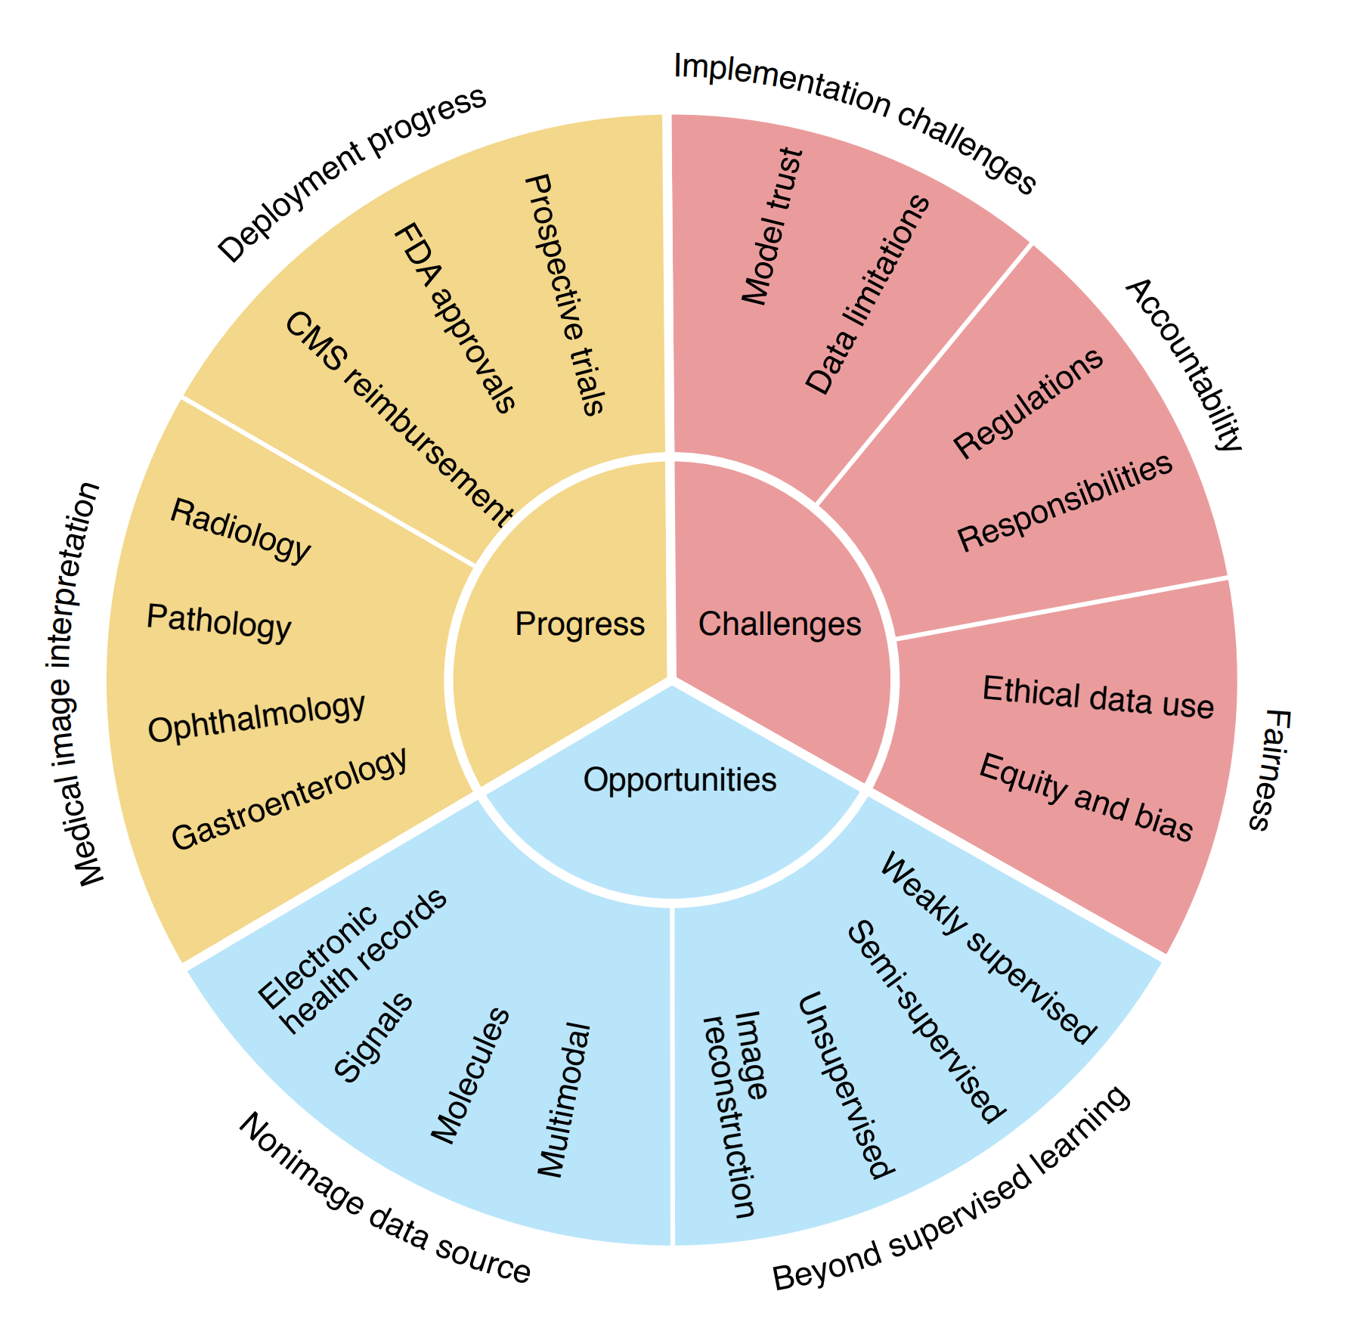
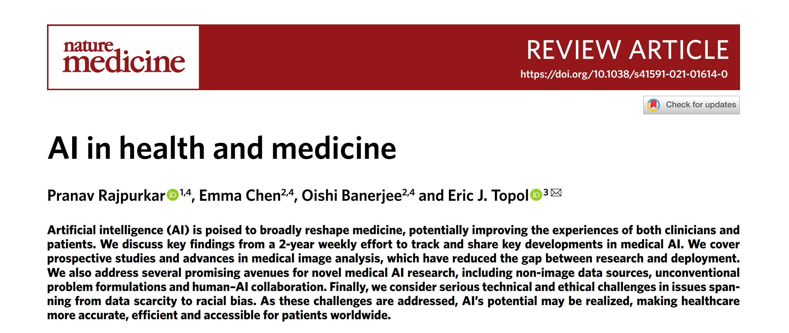

Where Are We At?
CMS, Centers for Medicare & Medicaid Services; FDA, Food And Drug Administration

Slide 4


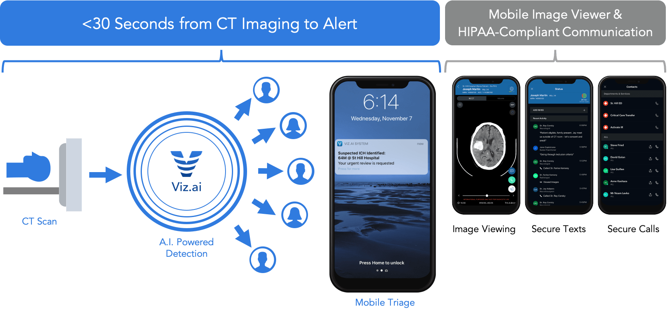
Deployment Progress
CMS, Centers for Medicare & Medicaid Services; FDA, Food And Drug Administration

Slide 5
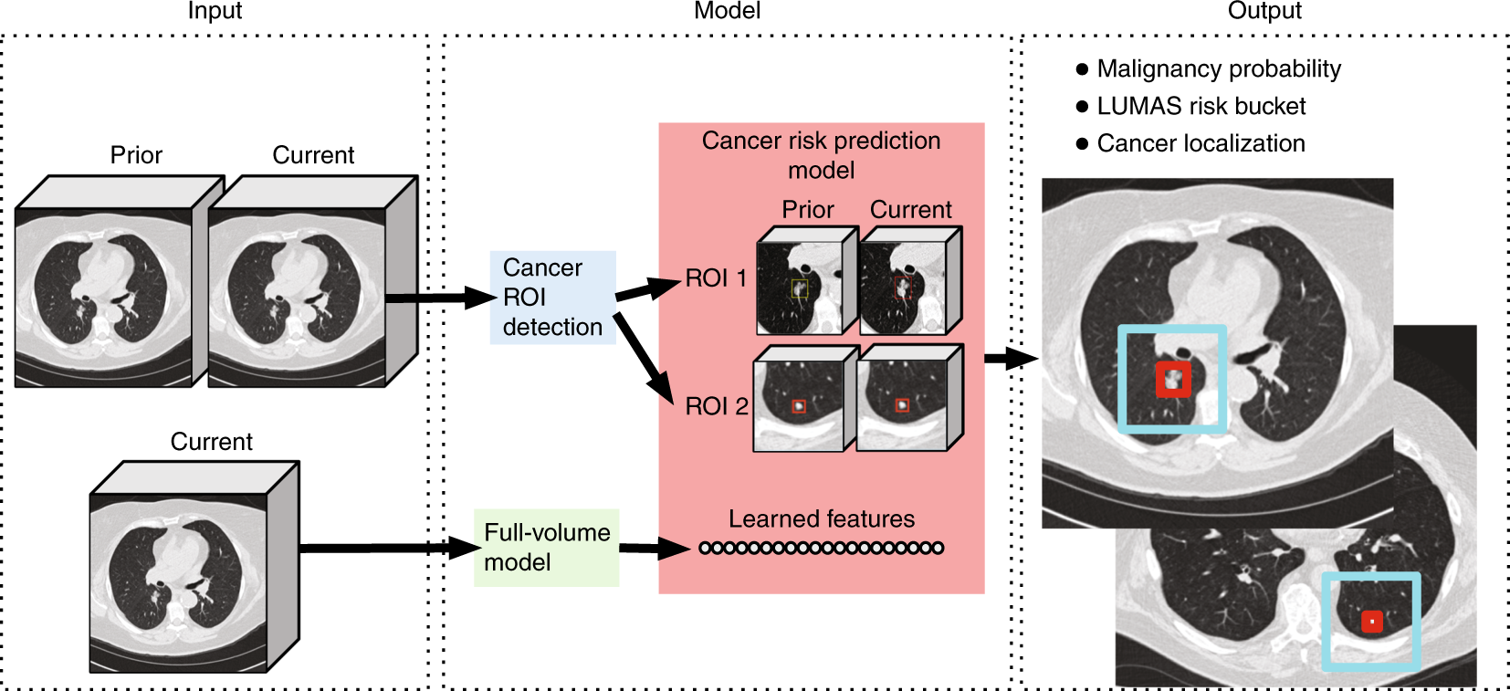
Medical Image Interpretation
End-to-end lung cancer screening with three-dimensional deep learning on low-dose chest computed tomography
Ardila, D et al., 2019

Slide 6

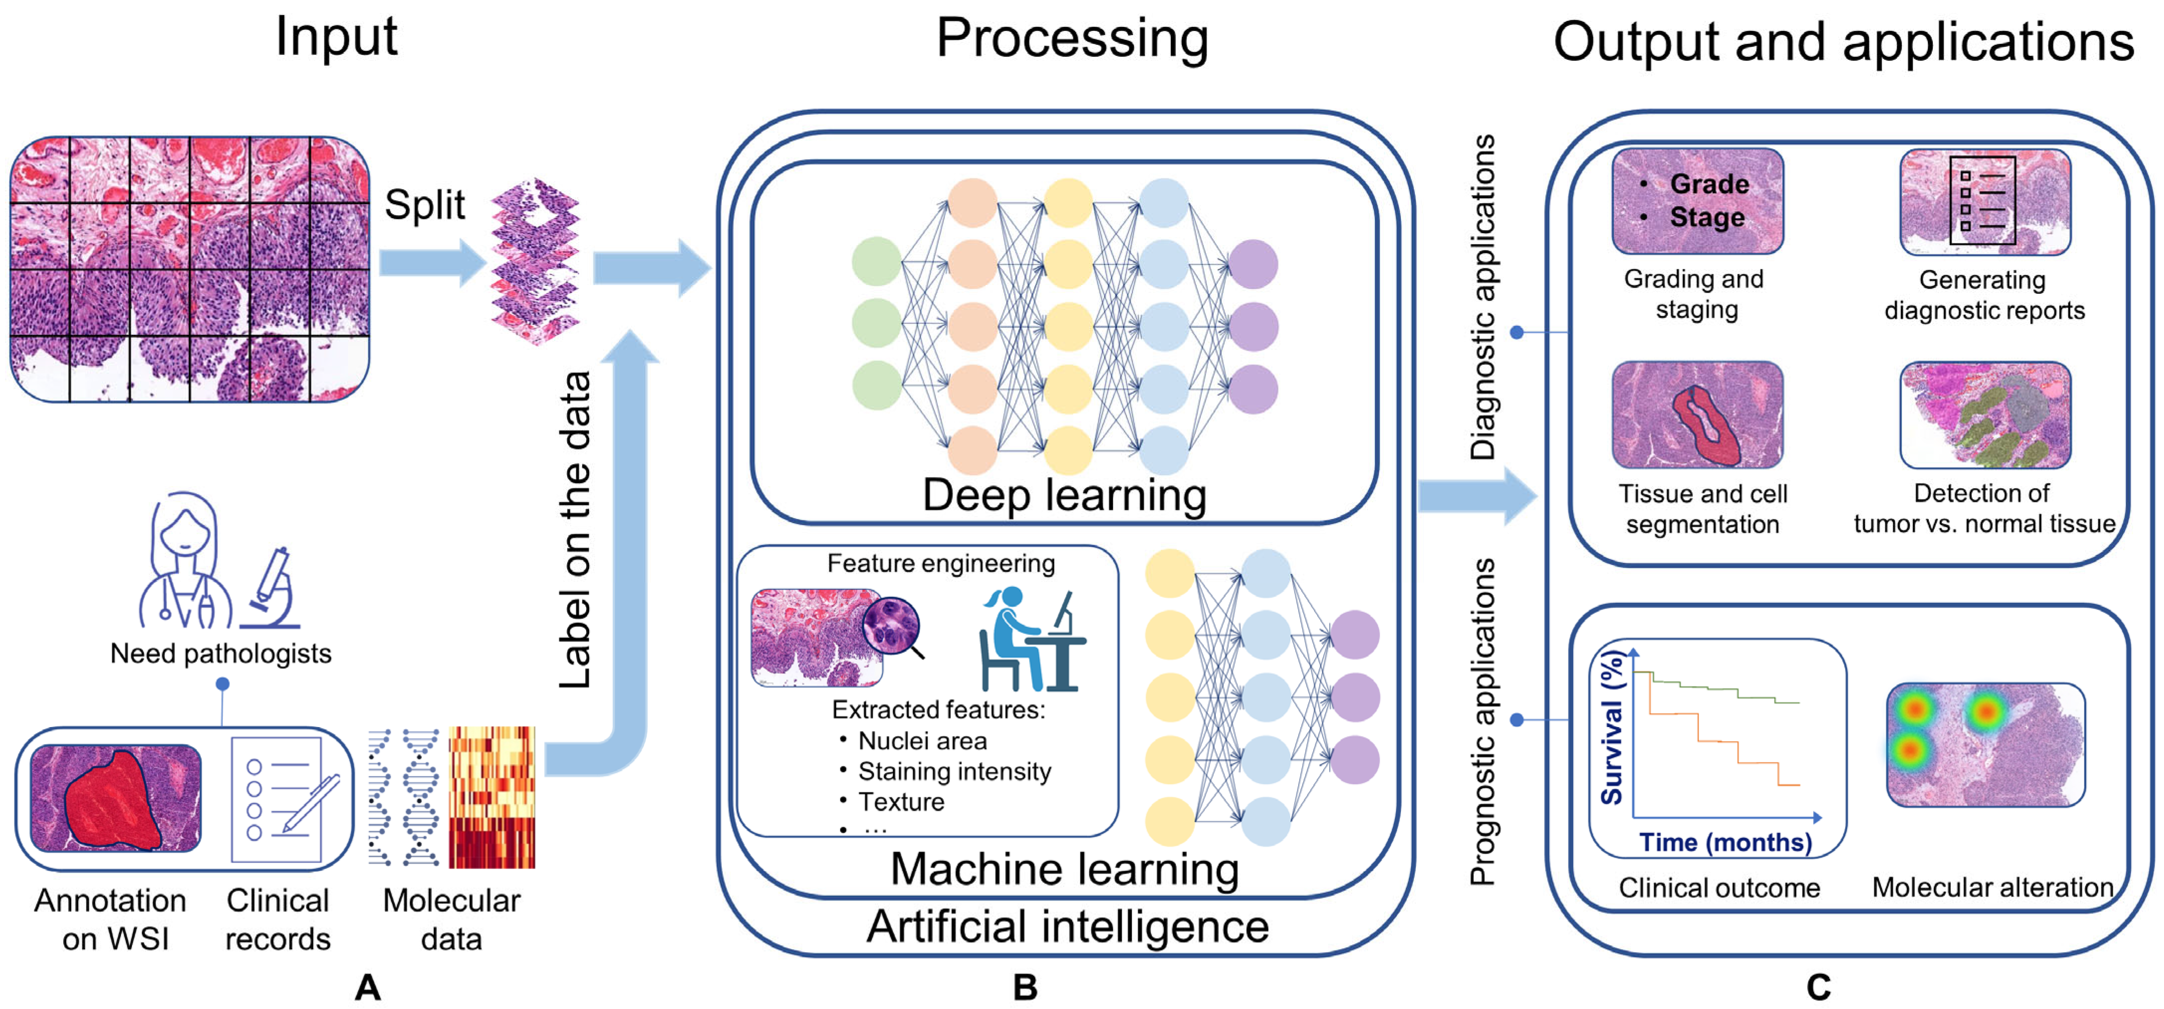
Medical Image Interpretation
Artificial Intelligence in Digital Pathology for Bladder Cancer: Hype or Hope? A Systematic Review
M. Zuiverloon et al., 2023

Slide 7
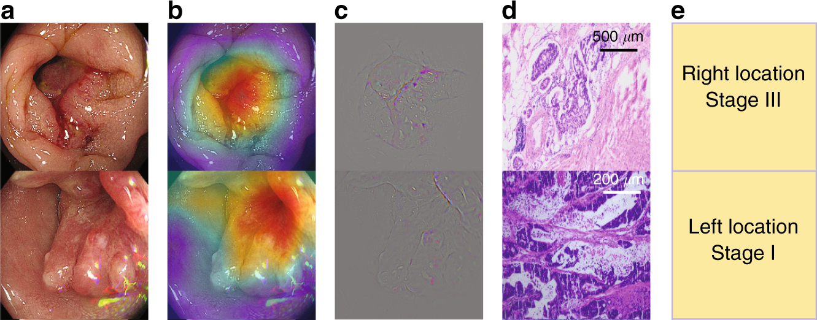
Medical Image Interpretation
Diagnostic evaluation of a deep learning model for optical diagnosis of colorectal cancer
Zhou. D. et al., 2020

Slide 8

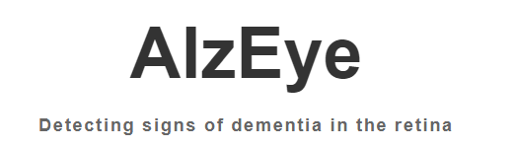
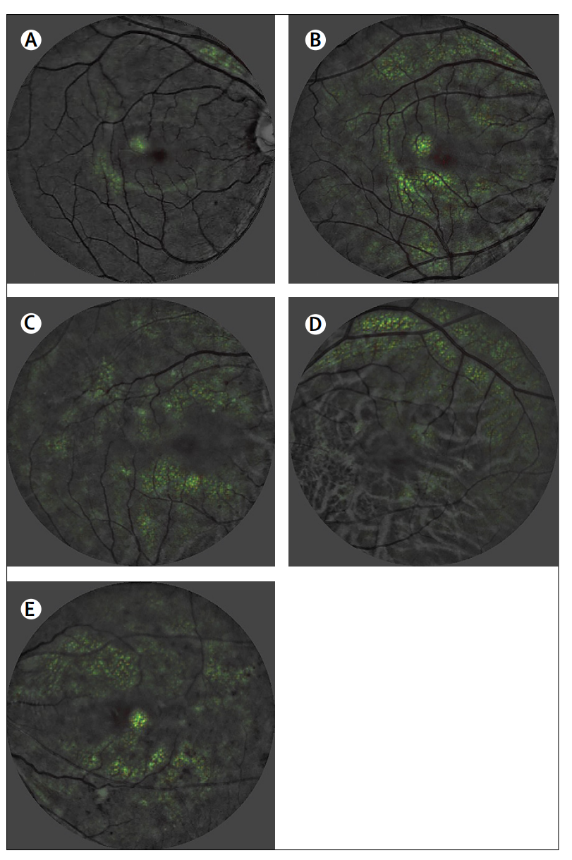
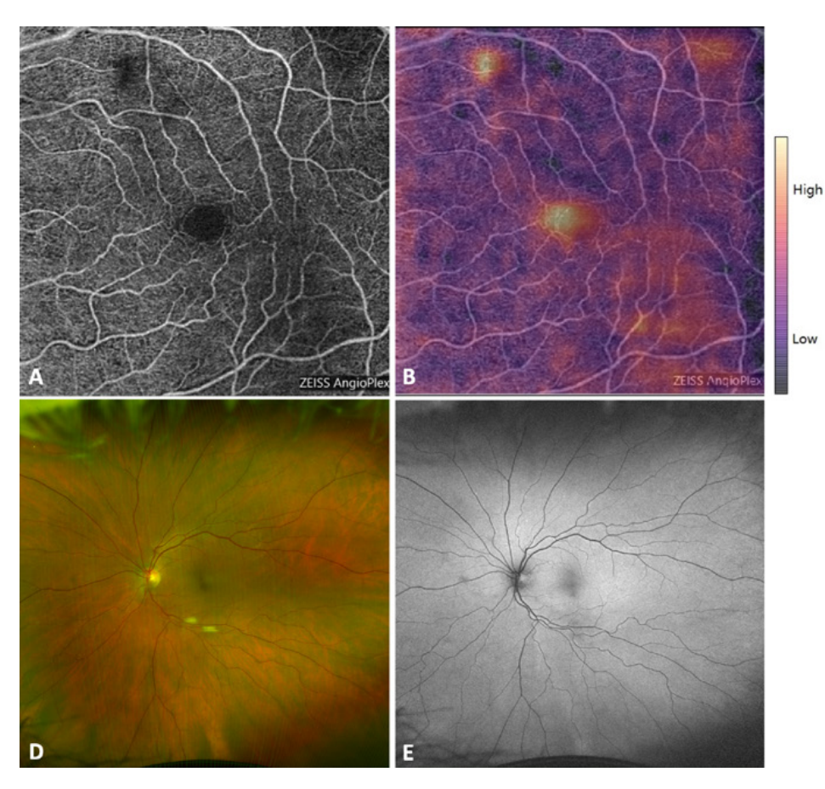
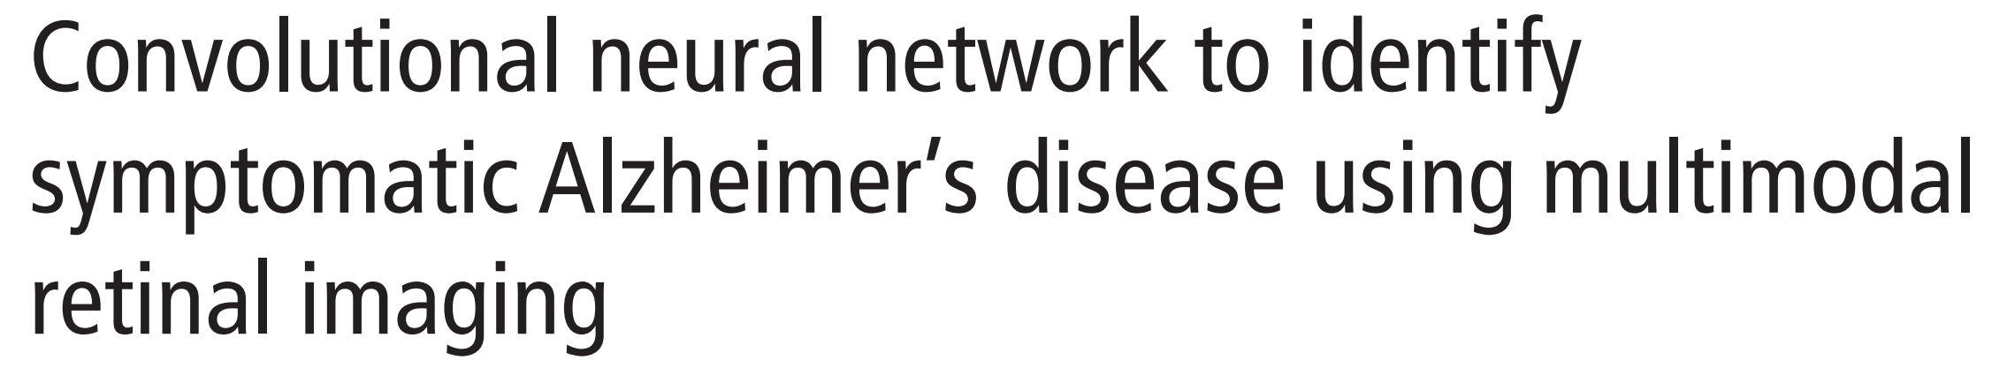

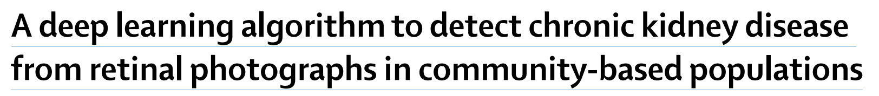
What We Can not See In The Retina
Wong et al., 2020
Fekrat et al., 2020

Slide 9


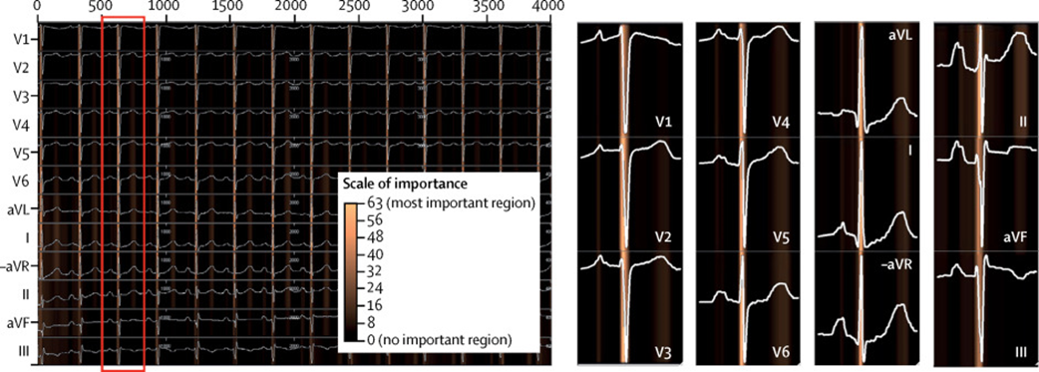
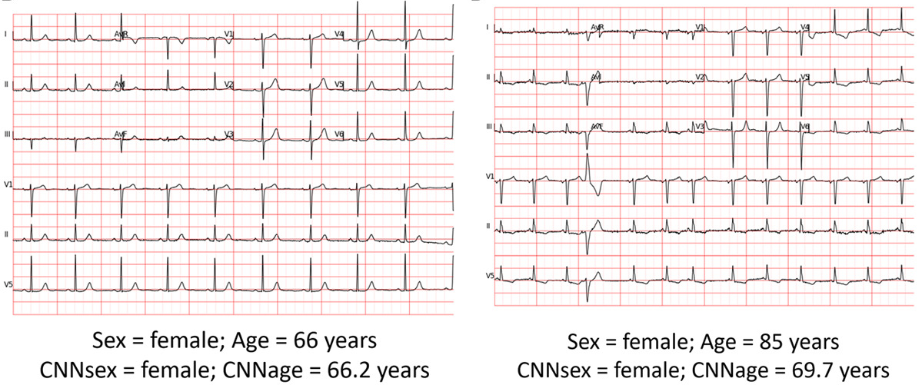
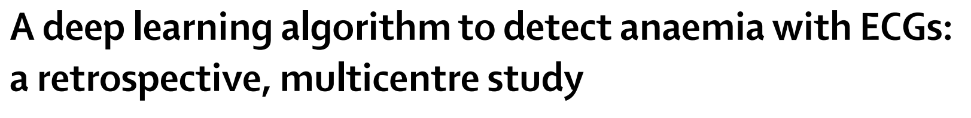
What We Can not See In The Electrocardiogram (ECG)
Age and Sex Estimation Using Artificial Intelligence From Standard 12-Lead ECGs
Cho et al., 2020
Kapa et al., 2019

Slide 10
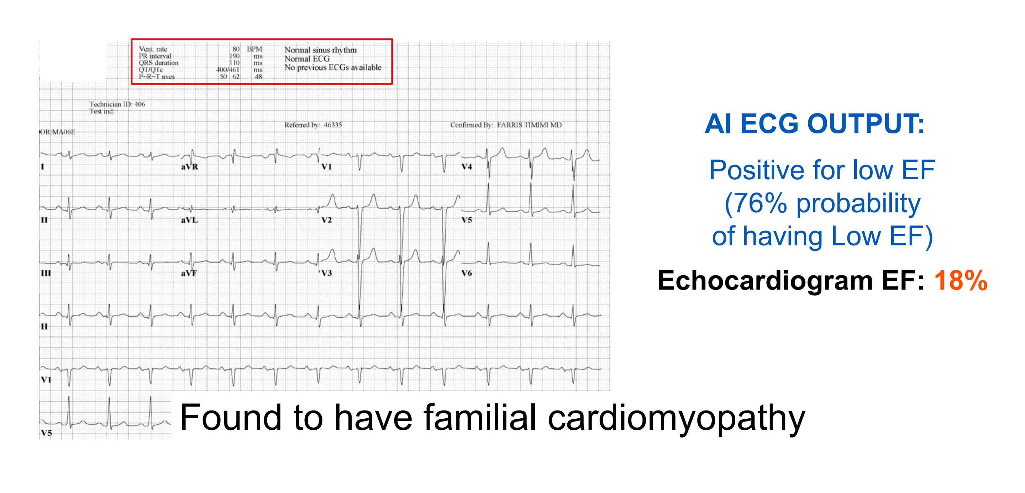
35 y old man presented after his sister sudden dies suddenly
https://aiforgood.itu.int/event/ai-in-health-and-medicine/

Slide 11
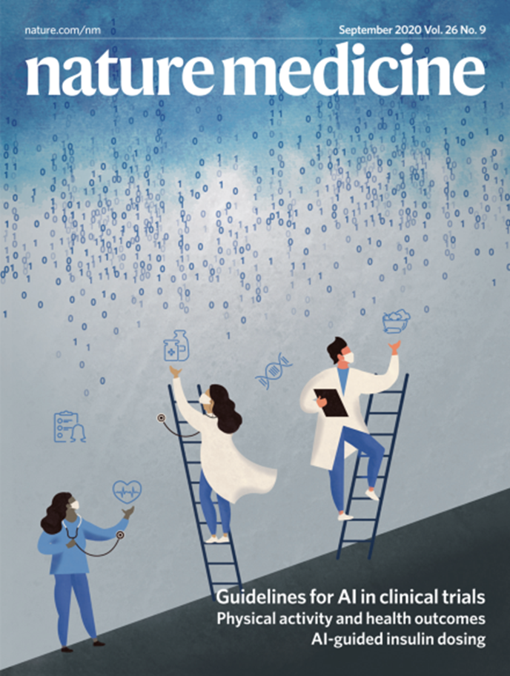
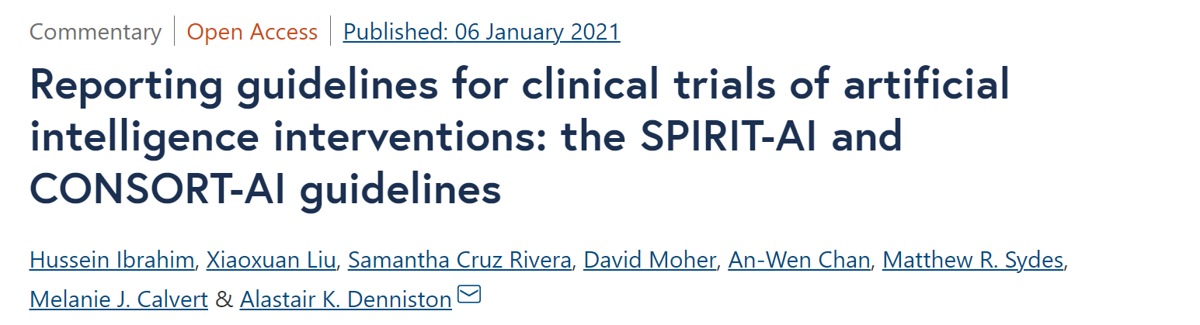
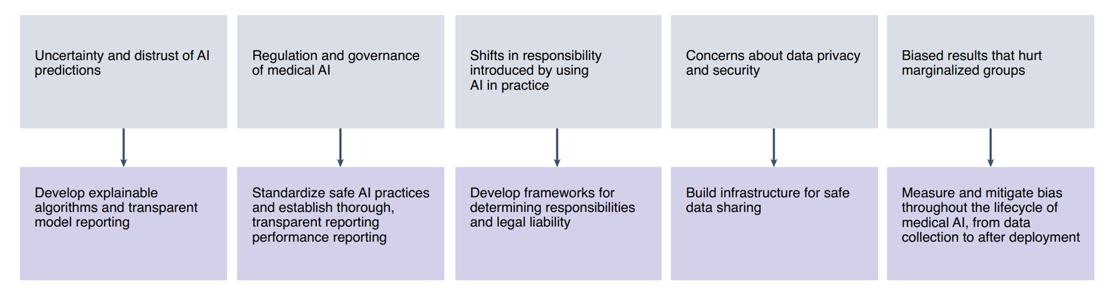
Challenges

Slide 12

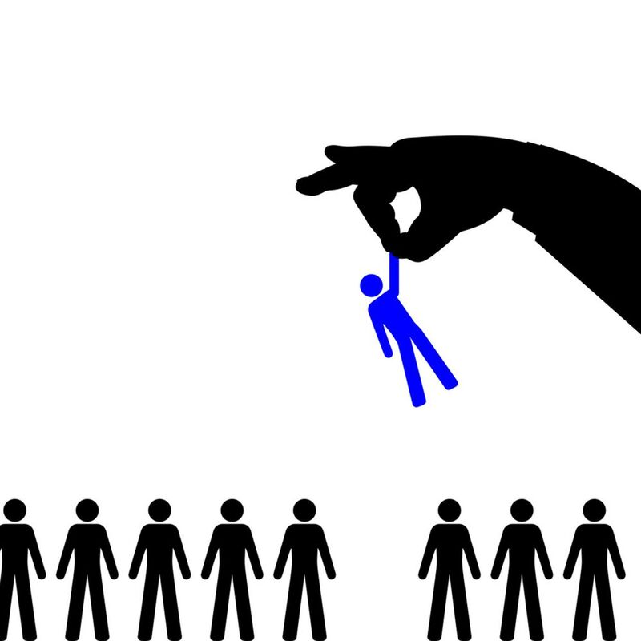

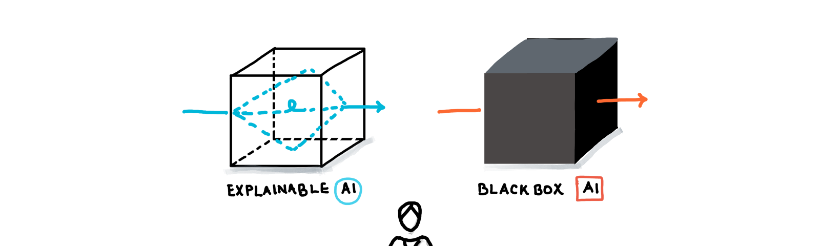
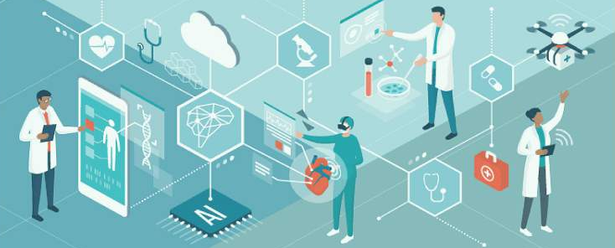

Challenges

Slide 13
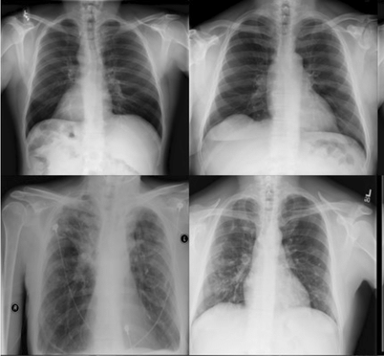
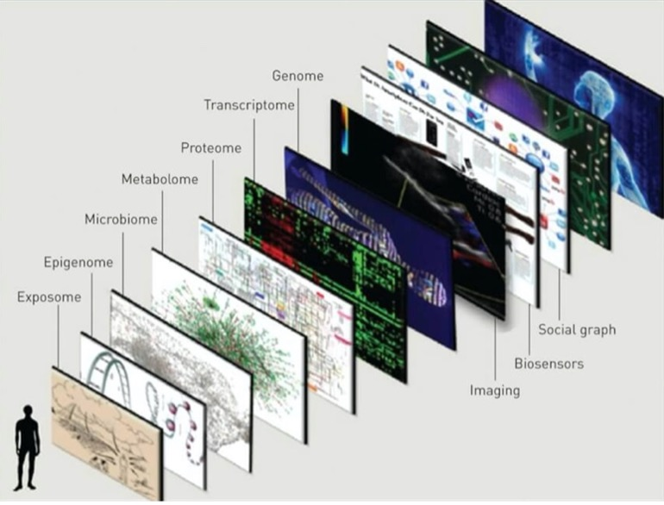
Opportunities for the development of AI algorithms
Input

Slide 14
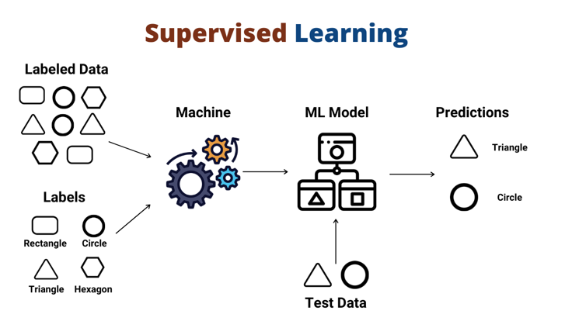
Opportunities for the development of AI algorithms
AI approach

Slide 15
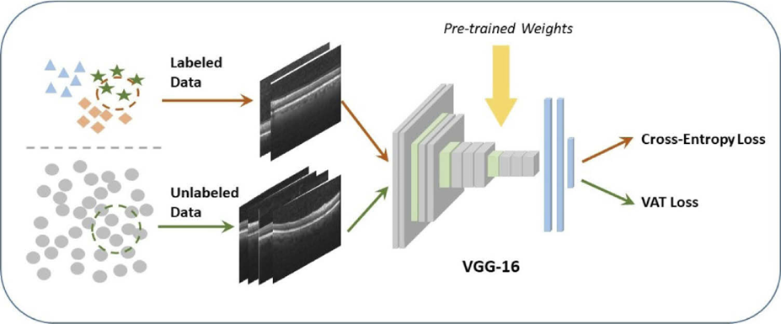
Opportunities for the development of AI algorithms
AI approach

Slide 16
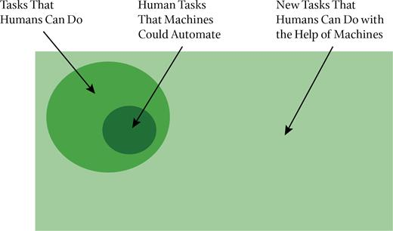
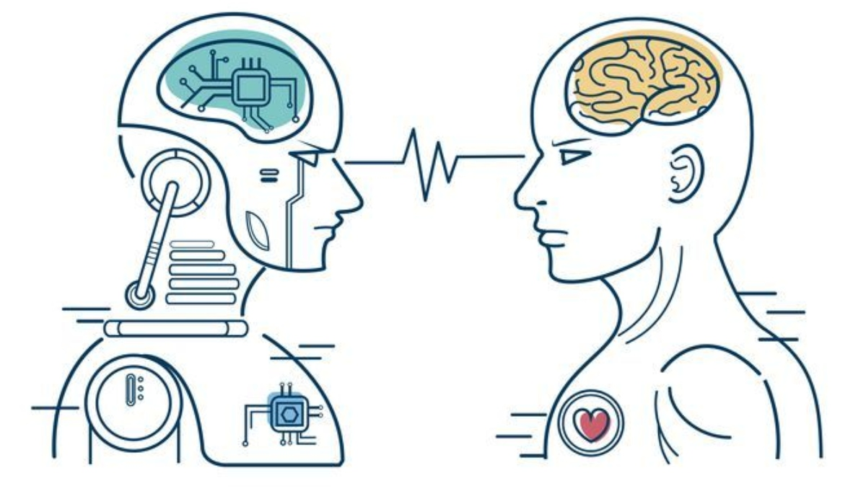
Opportunities for the development of AI algorithms
Setup

Slide 17
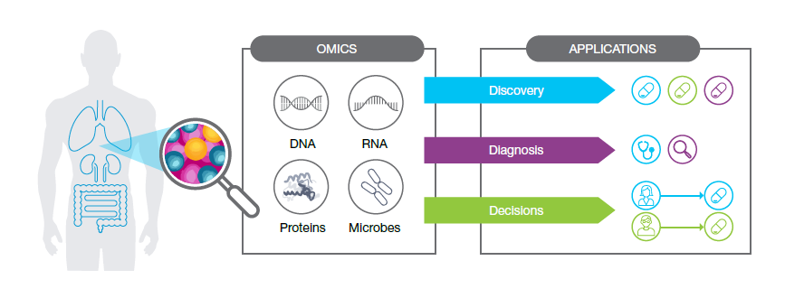
-Omics AI tools in clinical settings?
https://primeglobalpeople.com
Notes:
So, what do we do at Novo genomics?
[Pause]
Presently, we are focusing on omics-related clinical practices // We provide clinical services like WGS and WES-based diagnostics for germline and somatic diseases // we offer screening services like Non-invasive prenatal testing (or NIPT for short).
[Click]
Also, we are focusing on omics-related research and development through our partnership with LENOVO.
[Click]
and we are building a genomic tertiary analysis platform focused on the Saudi population.
But this is just the start [Click]

Slide 18

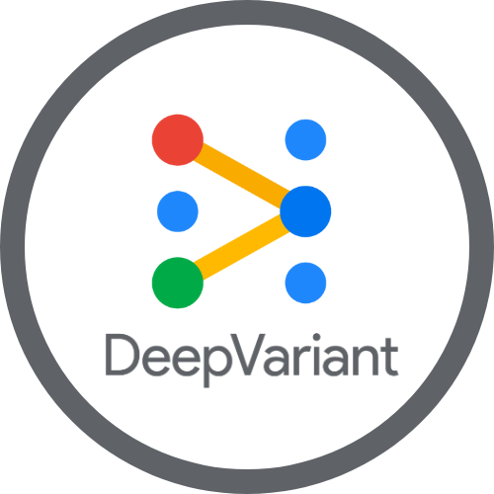
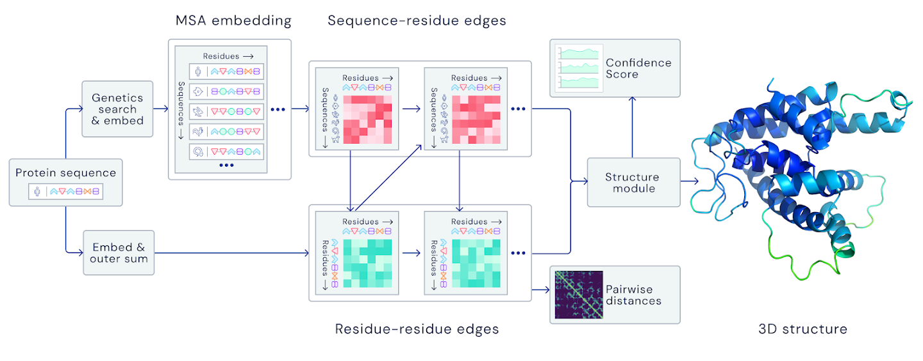
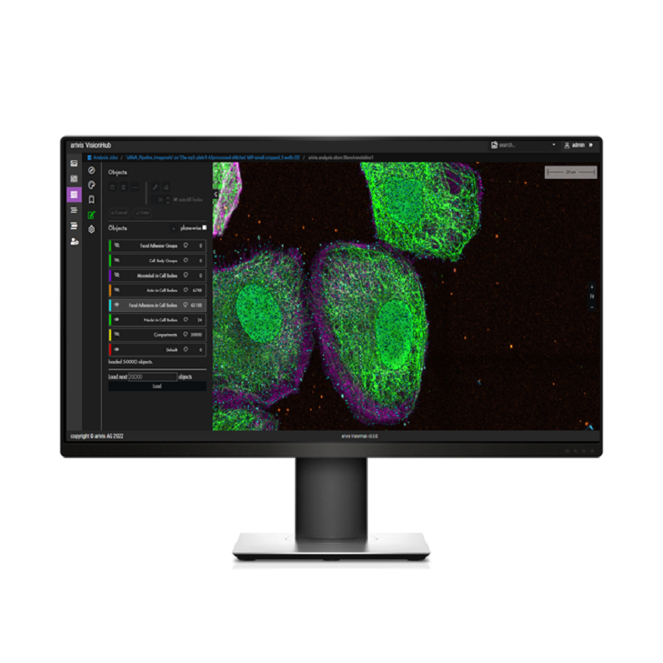
-Omics AI tools in clinical settings?
https://primeglobalpeople.com
Notes:
So, what do we do at Novo genomics?
[Pause]
Presently, we are focusing on omics-related clinical practices // We provide clinical services like WGS and WES-based diagnostics for germline and somatic diseases // we offer screening services like Non-invasive prenatal testing (or NIPT for short).
[Click]
Also, we are focusing on omics-related research and development through our partnership with LENOVO.
[Click]
and we are building a genomic tertiary analysis platform focused on the Saudi population.
But this is just the start [Click]

Slide 19
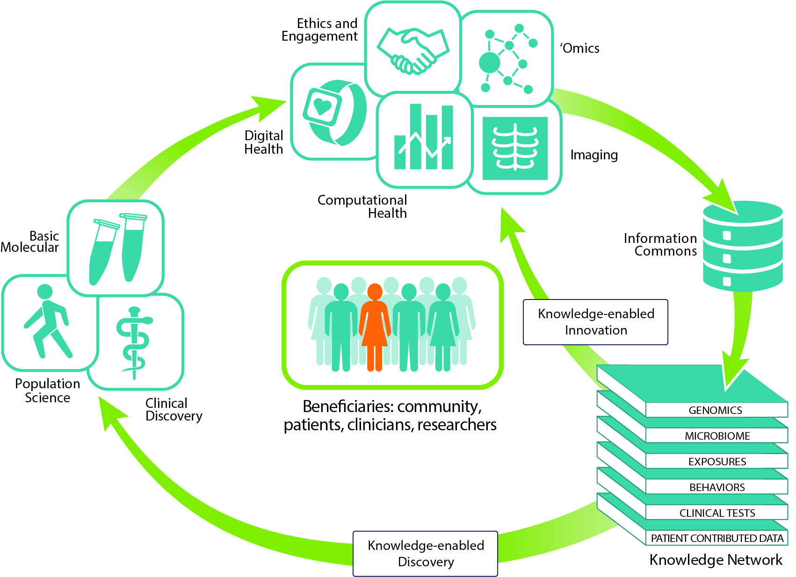
https://precisionmedicine.ucsf.edu/elements-precision-medicine
Notes:
Our ultimate vision is to build and connect the pieces of a dynamic circular ecosystem // something beyond genomics // including integrating basic, clinical, and environmental information obtained from many resources to enable innovation and health promotion //
[Pause]
All will benefit from such a system // community, patients, clinicians, and researchers.

Slide 20



Together for a healthier world
Thank you!
falmsned@moh.gov.sa
https://twitter.com/Fahad_Almsned
https://www.linkedin.com/in/fahad-almsned
Notes:
Thank you so much for your time!
Here are my email address and my Twitter and LinkedIn accounts. Please do not hesitate to contact me If you have any questions.
Thanks again!

